Slide 1

EduHub: MongoDB-Powered E-Learning Platform
By:
KOLA-ADEROJU, Abdulmalik Olayinka
ALT/SOD/025/1731
Kolaaderoju.Abdulmalik@gmail.com
(https://github.com/kolacodes-db)

Slide 2

Project Vision: Creating and Optimizing E-Learning
Objectives
Technological Stack
Key Features
Develop a scalable Learning Management System (LMS) capable of real-time tracking and personalized learning experiences for a diverse user base.
Leverage MongoDB for its flexible schema and scalability, integrated with Python PyMongo for robust backend operations and data manipulation. Others include Panda, datetime, Bson.object
Comprehensive user management with role-based access, a dynamic course catalog system, and powerful analytics for tracking student progress and platform performance.

Slide 3





Architectural Foundation: MongoDB Collections
Users
Referenced by Enrollments for relational mapping
Courses
Contains embedded Lessons and metadata for hierarchy
MongoDB Collection Architecture
Enrollments
Lessons & Assignments
References Users and Courses to link participants
Lessons embedded in Courses; Assignments nested in Lessons
Submission
This architecture prioritizes efficient data retrieval and storage, utilizing MongoDB's flexible document model to balance hierarchical embedding with relational linking for optimal performance.

Slide 4
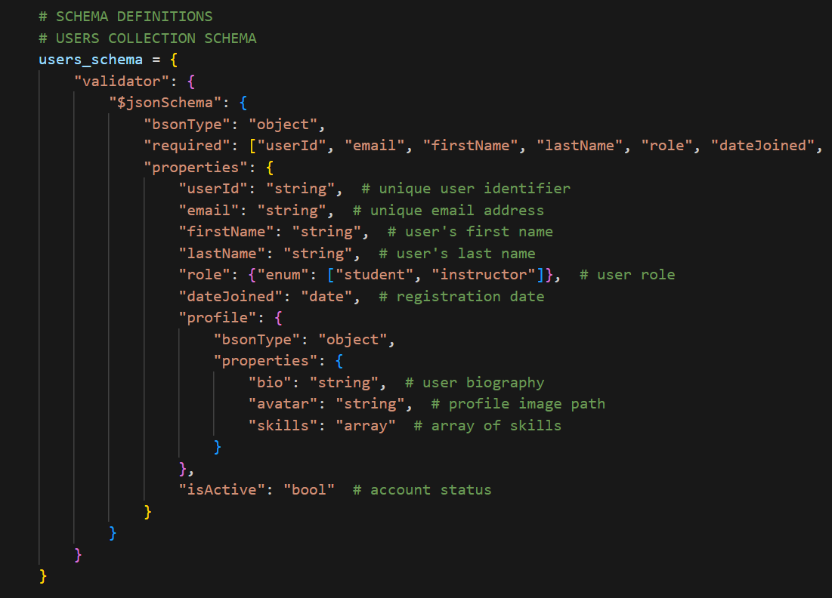
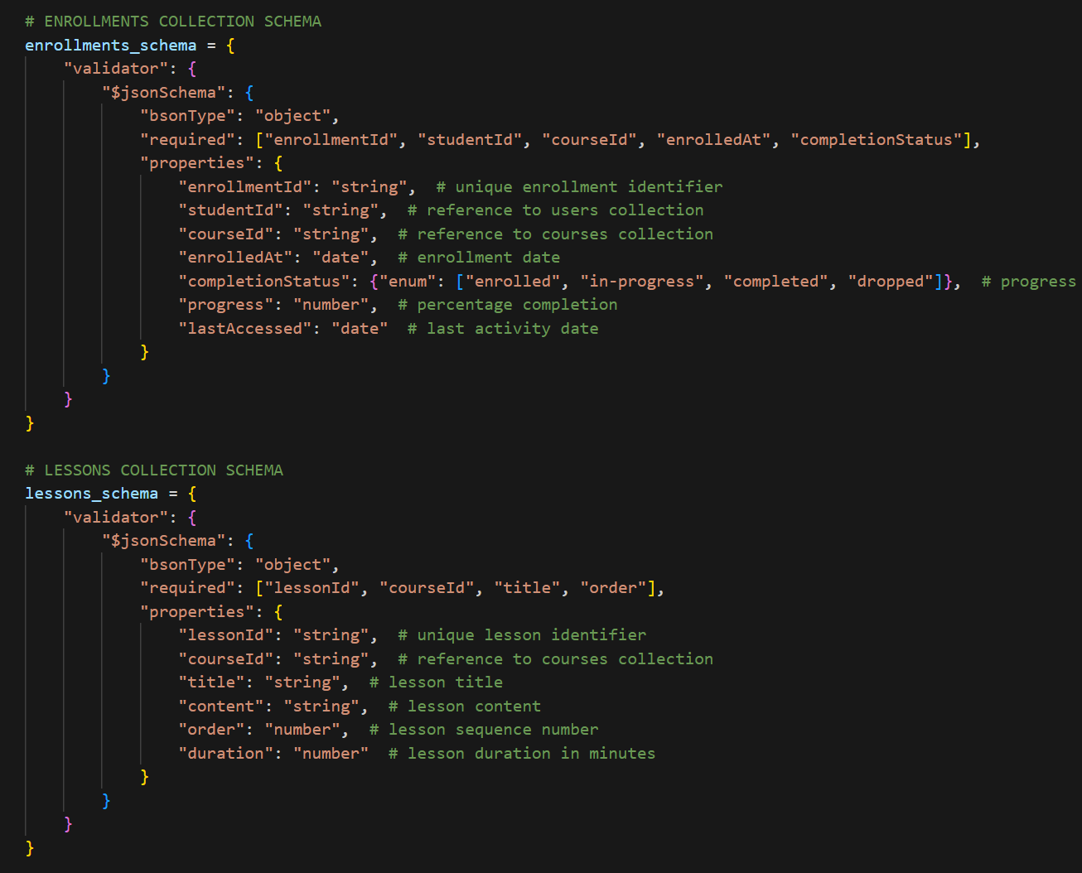
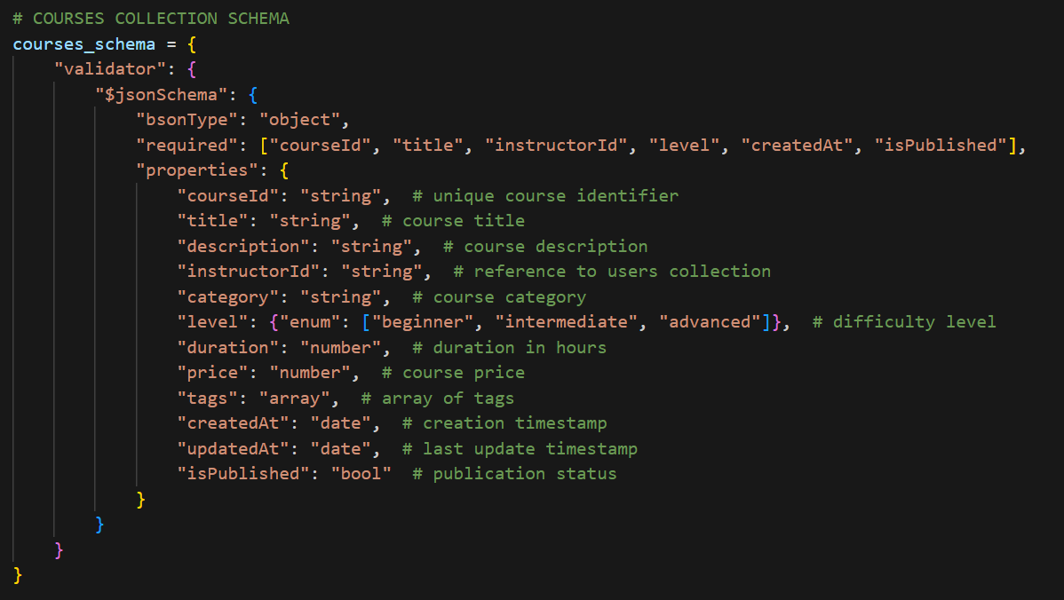
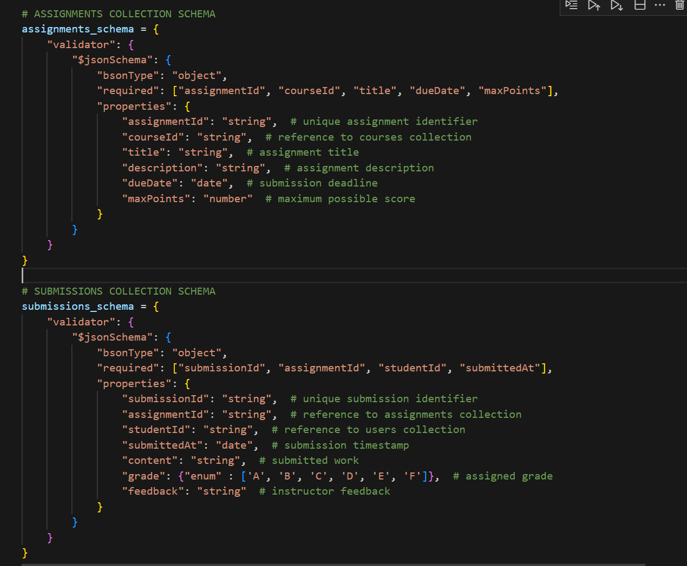
User-Centric Design
Hierarchical Course Structure
Consolidated user profiles with distinct roles (student, instructor, admin) streamline access control and personalization.
Courses are modeled with embedded documents for modules and lessons, enabling easy traversal and content organization.
This model ensures both data integrity and optimized performance for the most common platform operations.

Slide 5
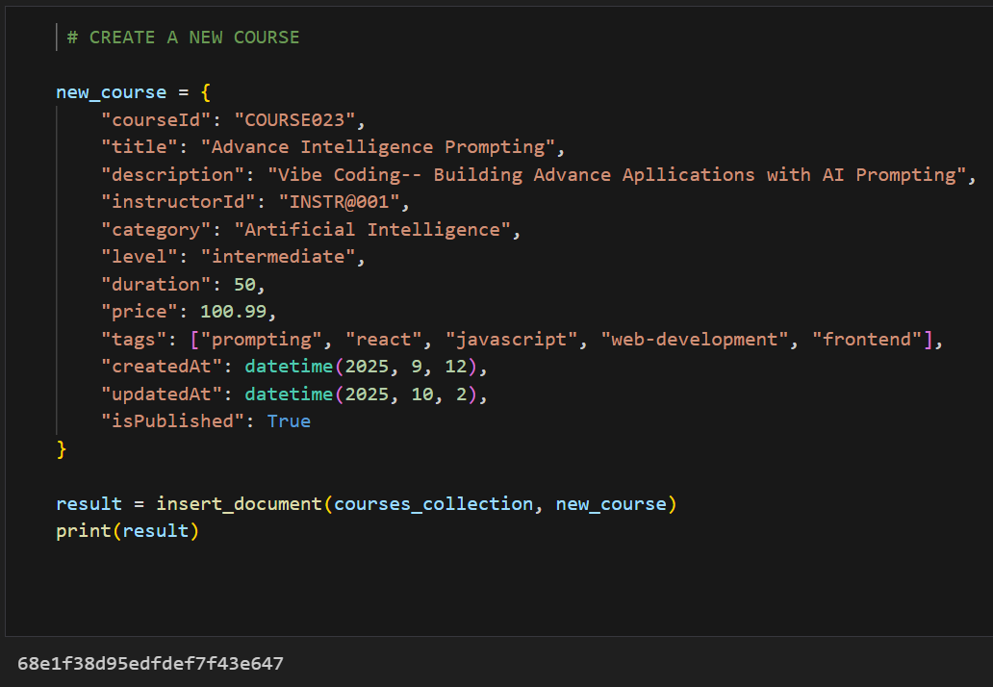
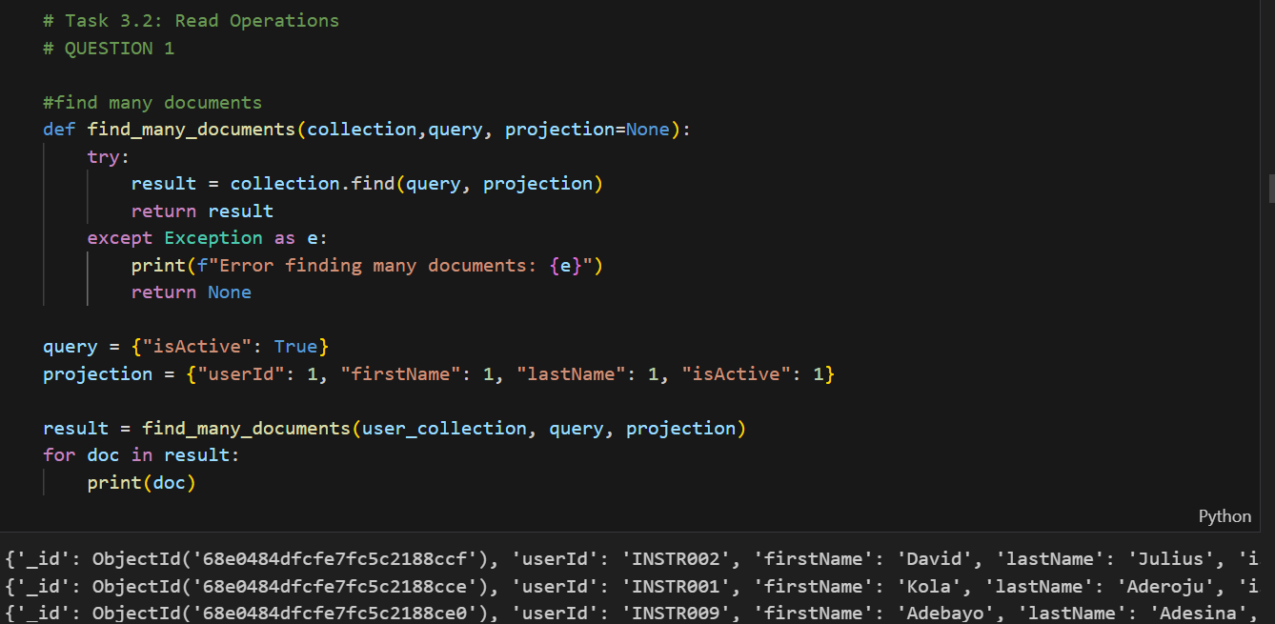


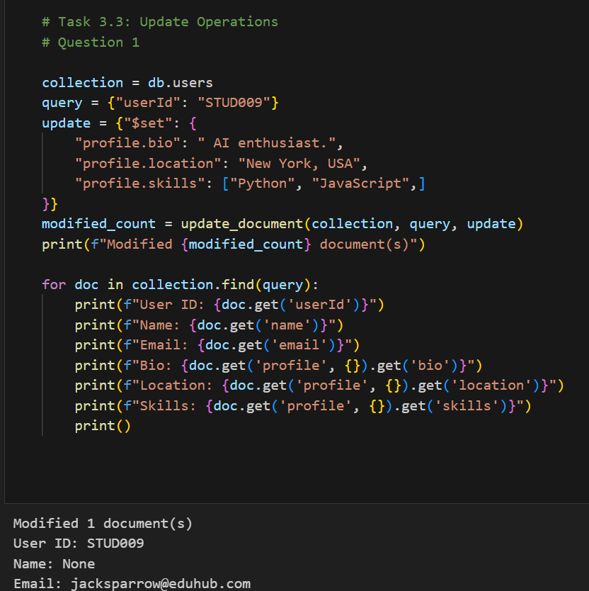
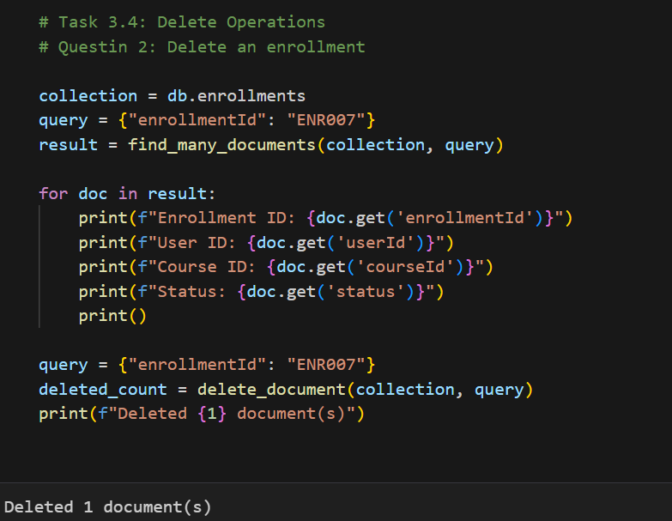


CRUD Operations:
Create
Seamless creation of new users, courses, enrollments, and assignment submissions.
Read
Complex queries support course search, user dashboards, and related content retrieval.
Update
Efficient updates for student progress, assignment grades, and user profile information.
Delete
Implementation of soft-delete mechanisms to maintain data integrity and audit trails.

Slide 6
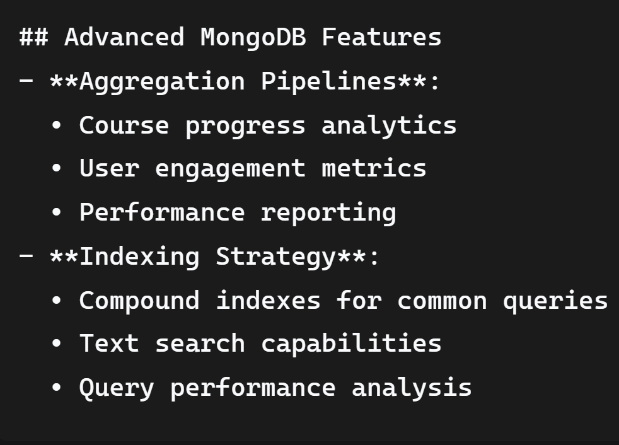
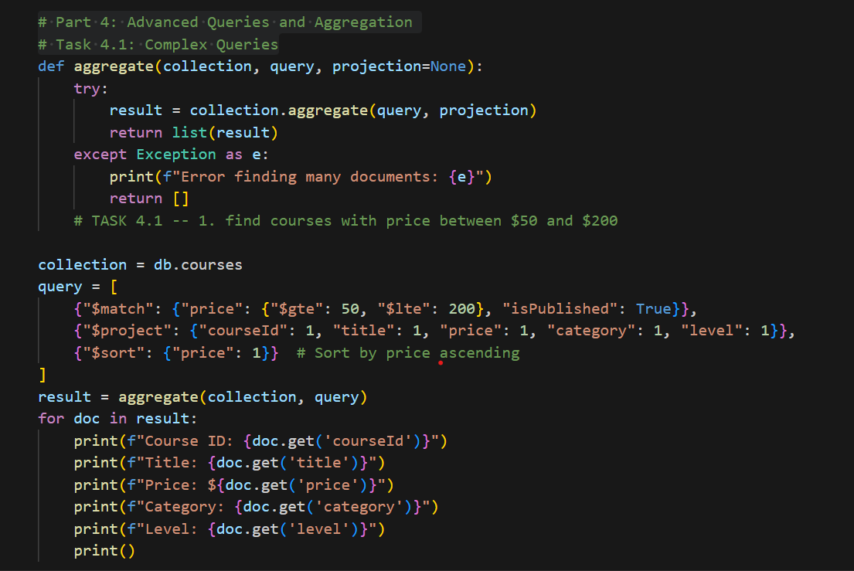
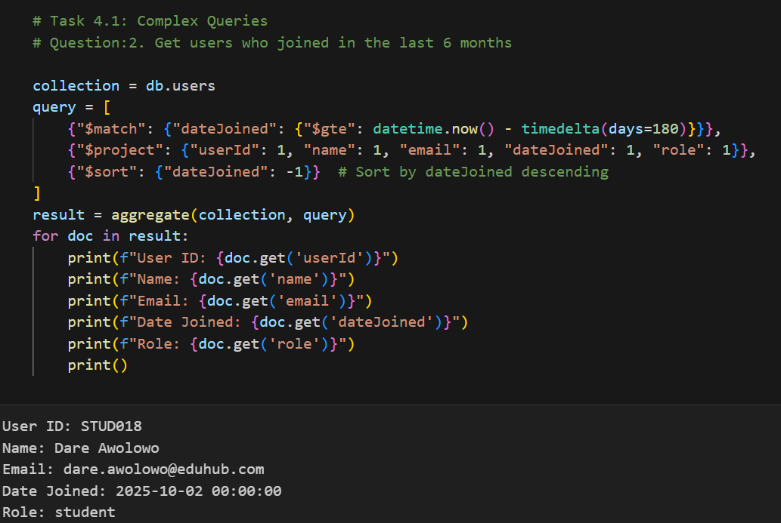
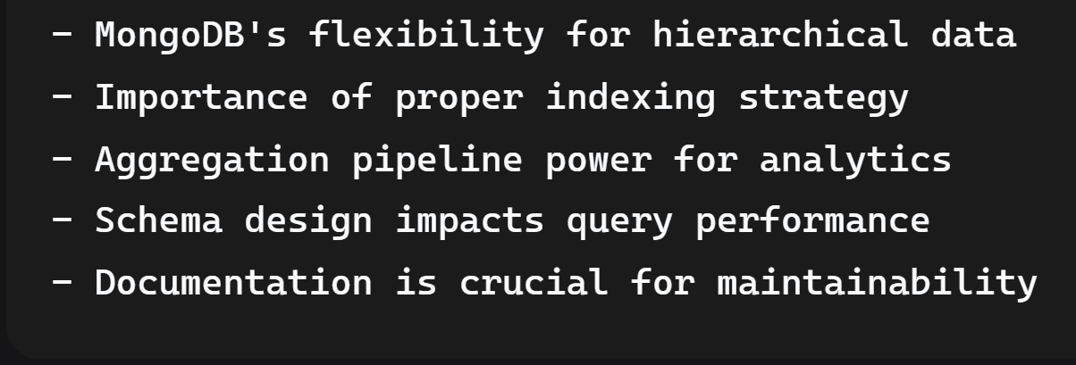
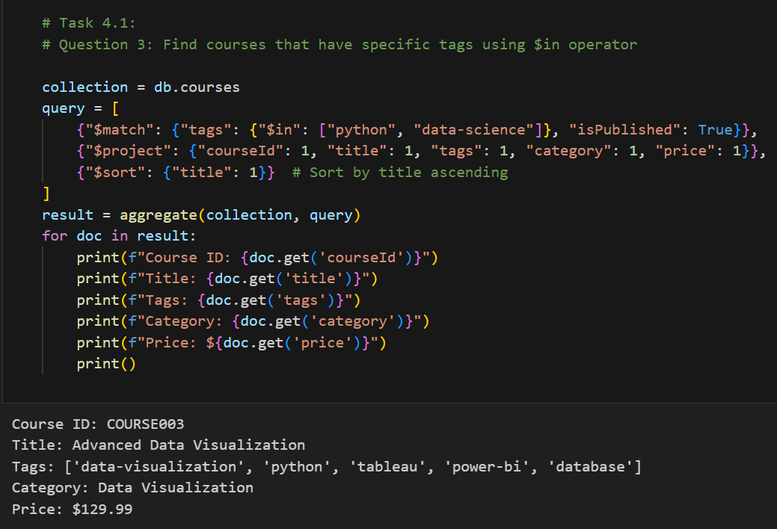
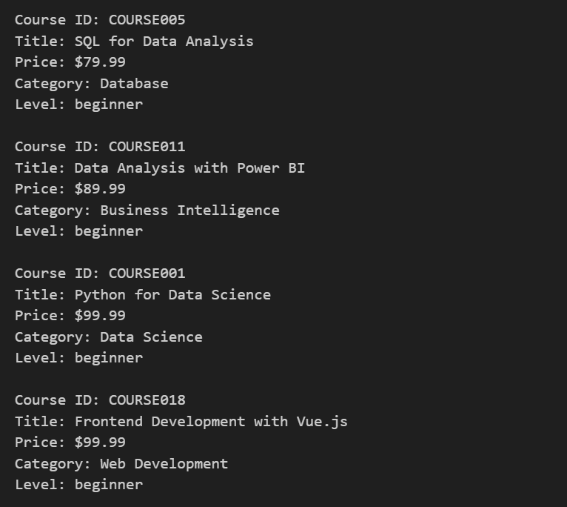
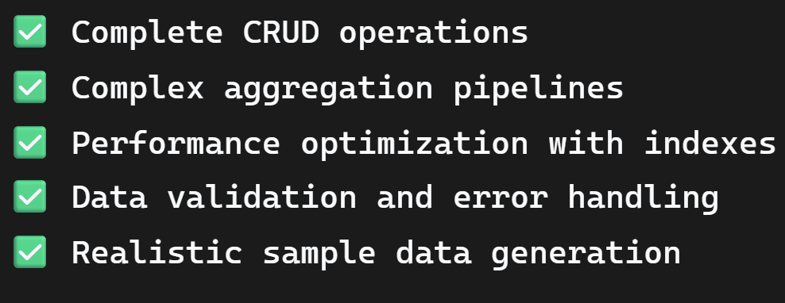

Slide 7
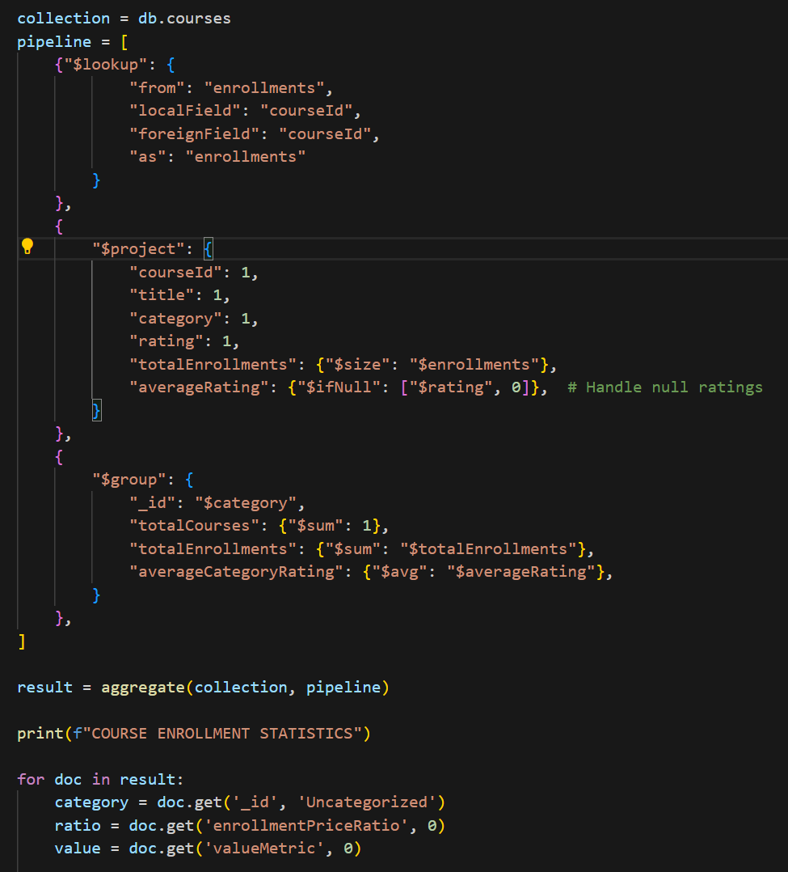
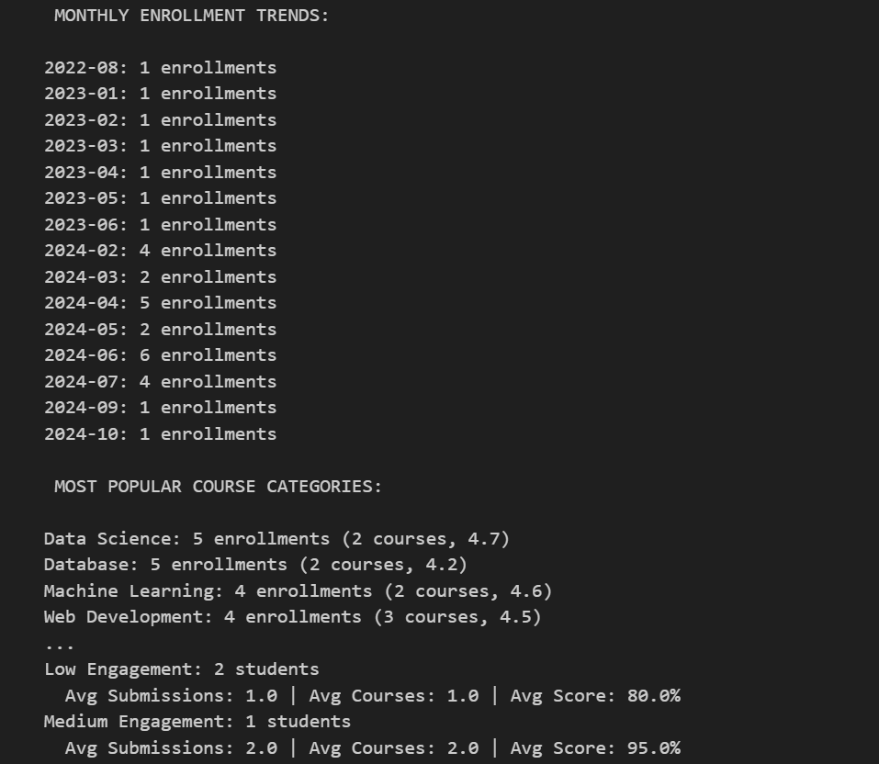
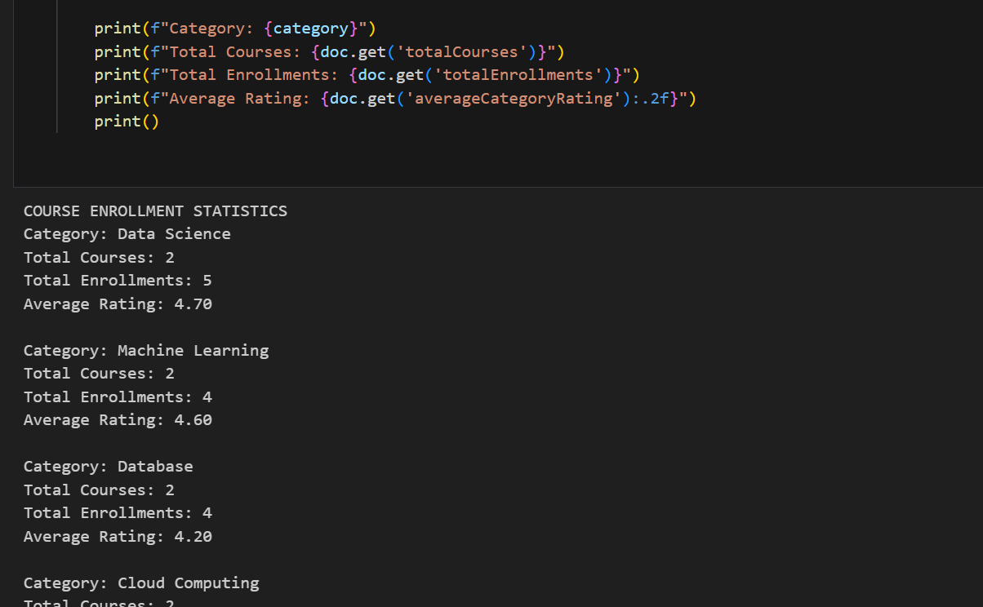
Advanced Analytics: Insights for Improvement
Enrollment & Performance
Enrollment Analytics: Track trends by course category, popular topics, and peak enrollment periods to inform content strategy.
Performance Analysis: Monitor student grades, completion rates, and time-to-completion to identify learning gaps and effective strategies.
Instructor Analytics: Provide instructors with dashboards showcasing student engagement, course popularity, and potential revenue contributions.
Also, Data cleaning Functions was created to eliminate duplicate object. The schema Validator was initialized for better performance, Additional values like “score, catrgory_rating” was assigned for easier aggregation

Slide 8



Ensuring Robust Data Integrity
Consistency
1
Referential integrity for linked data and atomic operations for critical updates.
Error Handling
2
Mechanisms for duplicate prevention and graceful recovery from data entry errors.
Validation
3
Strict validation rules for required fields, data types, and email formats.
The data integrity measures safeguard the EduHub platform, ensuring reliable and accurate information for all users.

Slide 9
Achieving Peak Performance: 8x Faster Queries
120ms
15ms
Before Optimization
After Optimization
Average query response time without specialized indexing or query tuning.
Achieved significant reduction in query time through strategic interventions.
"Through meticulous indexing, fine-tuned query optimization, and efficient pipeline tuning, we slashed average query times by a factor of eight, dramatically improving user experience."

Slide 10

Overcoming Technical Challenges
Aggregation Pipelines
Optimizing complex data processing flows for real-time analytics.
Data Relationships
Maintaining consistency and referential integrity across interconnected collections.
Query Performance
Developing an effective indexing strategy to ensure rapid data retrieval.
This solutions involved incremental testing, thoughtful schema design, and continuous performance optimization.

